Slide 1

Sapfir s.r.o.
Pulse powder fire extinguishing systems SAPFIRE
2017

Slide 2
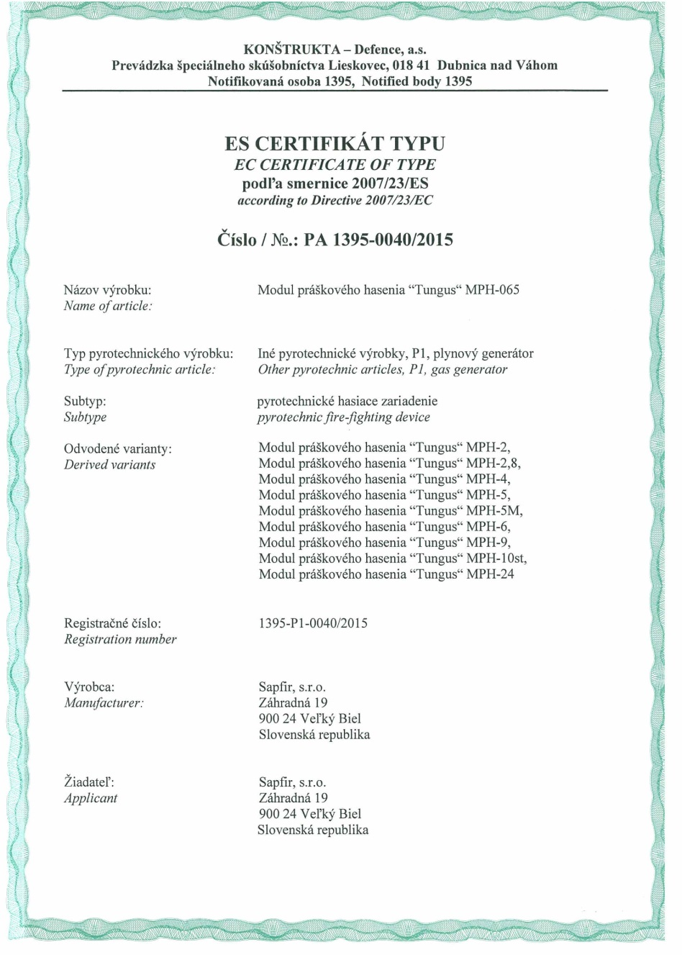
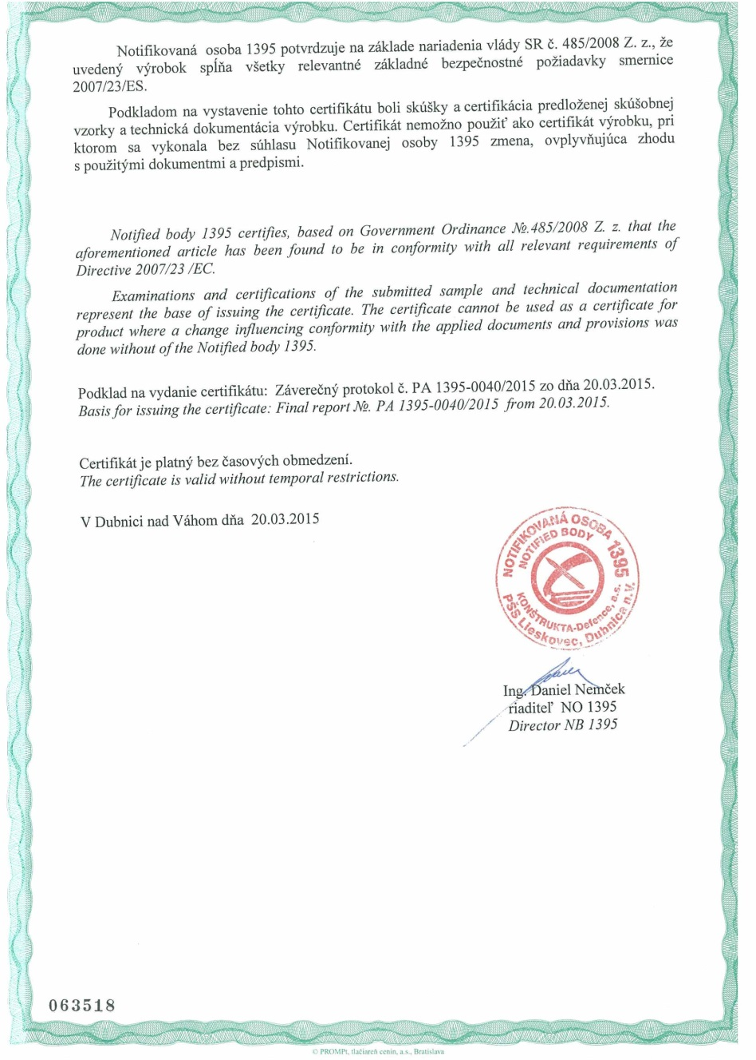

CE Certificate

Slide 3
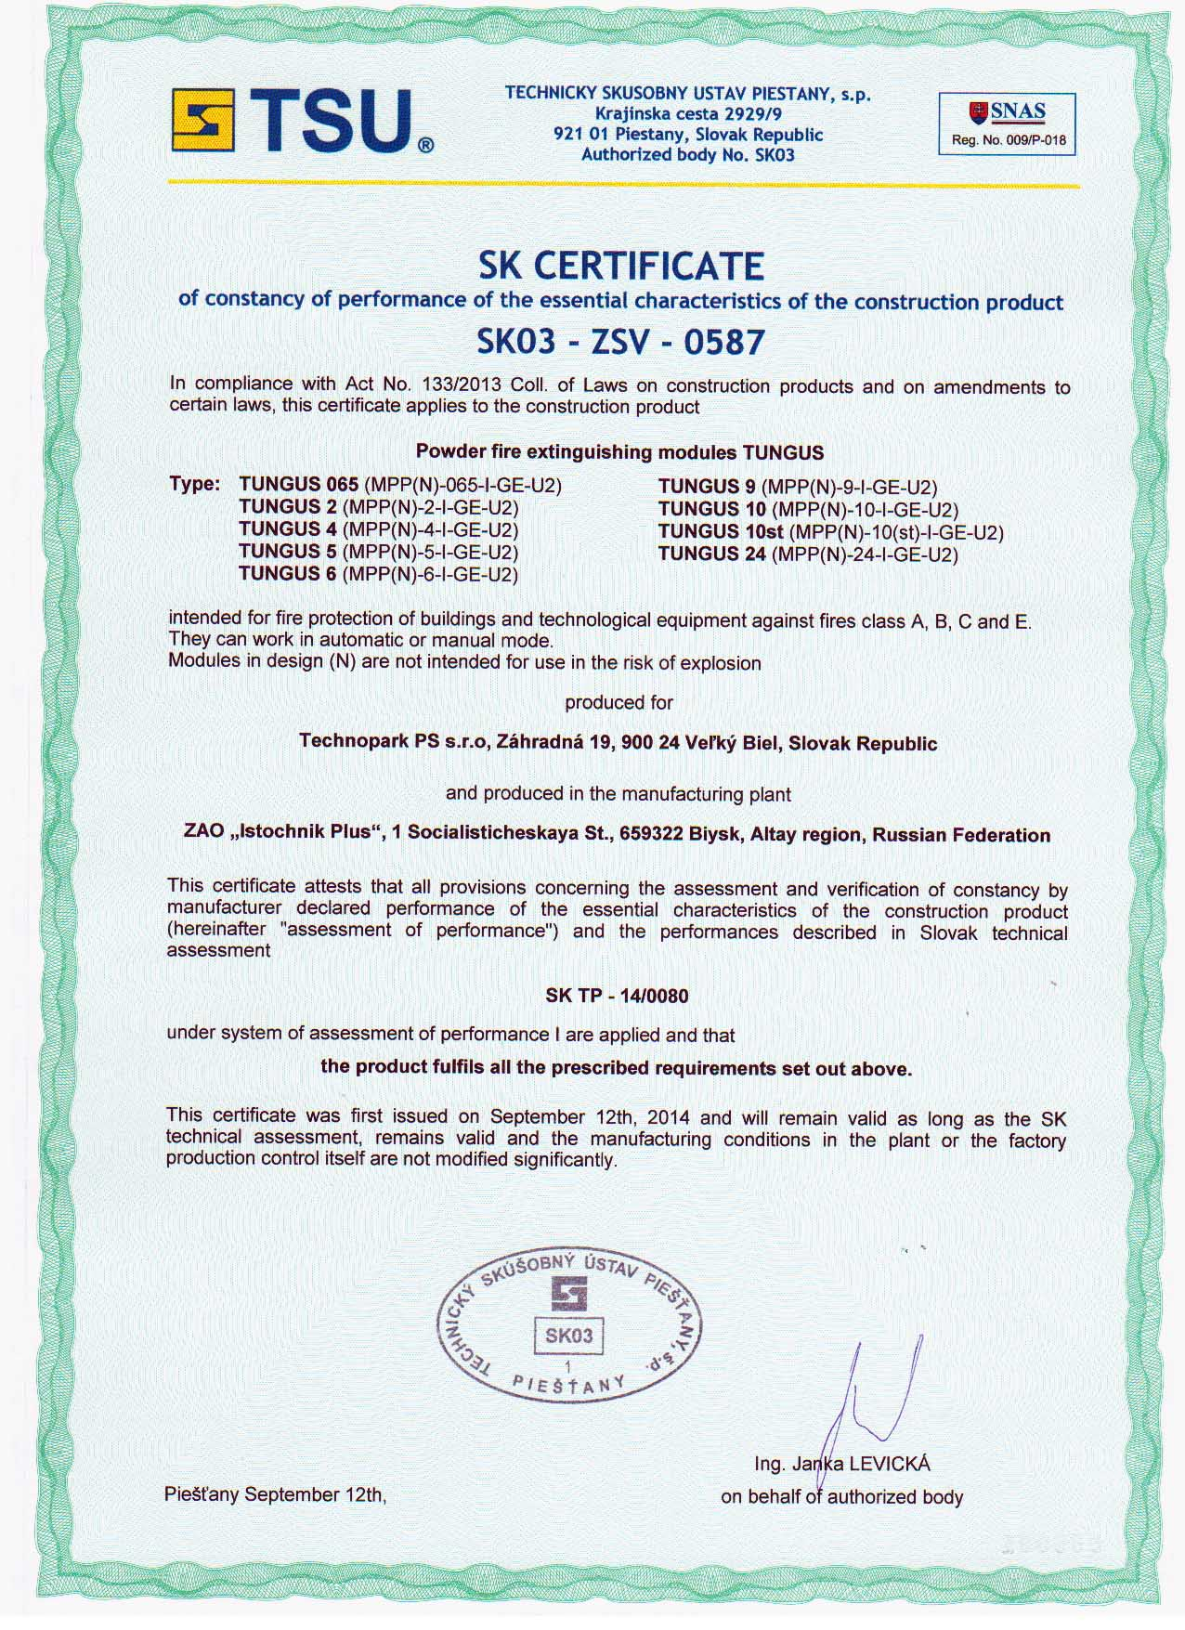
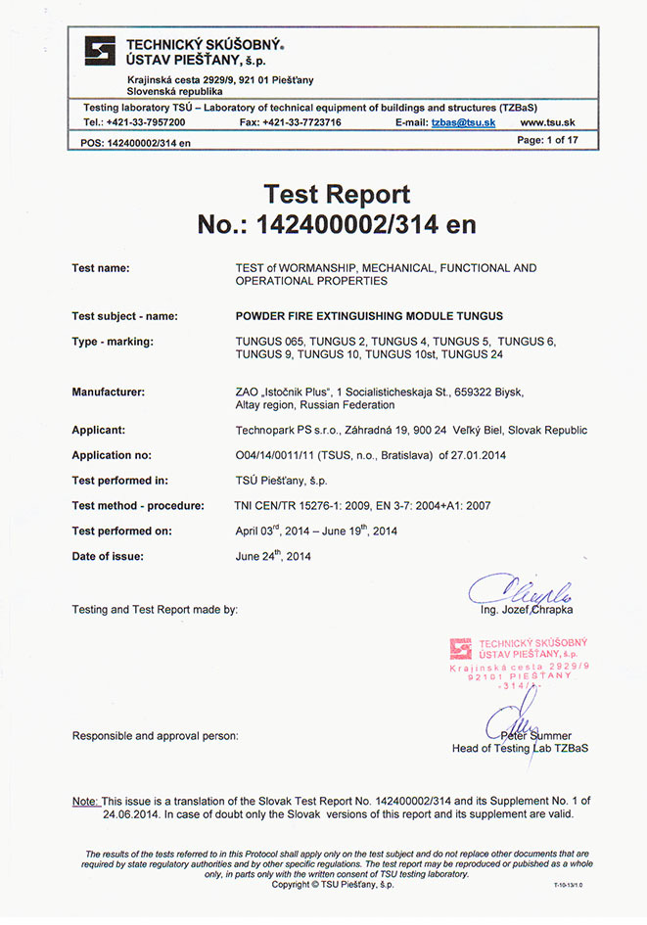
Certificate of Compliance

Slide 4
Why choose MPH “TUNGUS”?
High reliability and efficiency
Relatively low price
12 years of operation without the necessary maintenance
Easy installation and operation
Blocking the fire at an early stage in the self-triggering or automatic modes
Versatility – can extinguish fires of all classes, including electrical units under voltage
Ability to extinguish by both: Volume and Surface
Minimal damage in case of fire in buildings in comparison to water extinguishing
Cheap maintenance

Slide 5
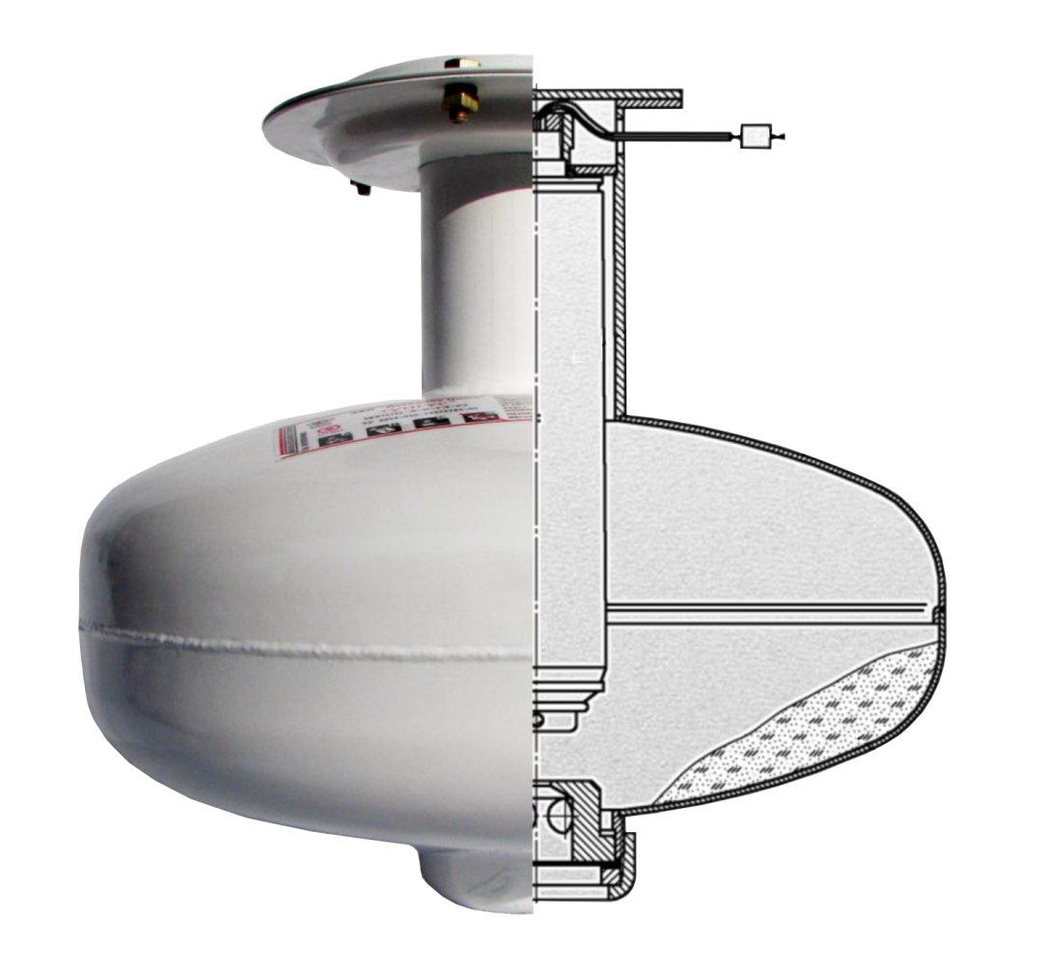
Construction of a module
4
1 - Trunk of a module
2 – Fire extinguishing powder
3 - Cold gas generator
4 - Electric activator
5 - Dispenser
6 - Membrane
3
1
5
2
6

Slide 6
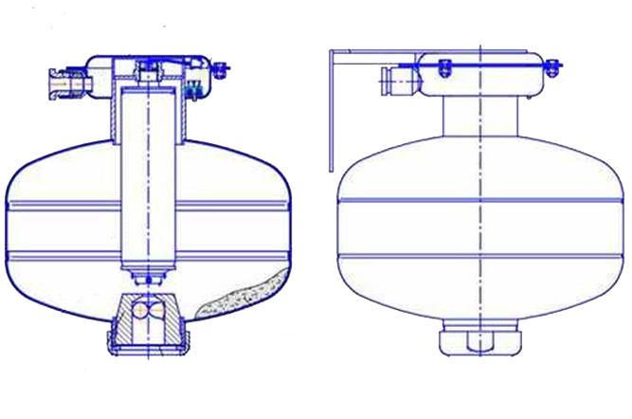
Construction of a module
8
6
9
10
1 - Trunk of a module
2 – Fire extinguishing powder
3 - Cold gas generator
4 - Dispenser
5 - Membrane
6 - Electrical box
8 - Electrical input
9 - Mount cover
10 - Console
1
7
2
3
11
4
5

Slide 7
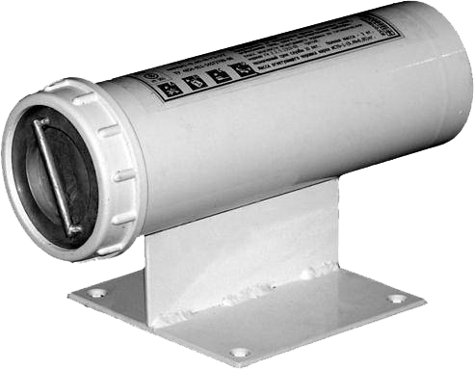

MPH - 0.65
Technical parameters
Name of a parameter |  | Value
The volume of housing, liter |  | 0.49
Total weight, kg |  | 3.0
Weight of the fire extinguishing powder ISTO-1, kg |  | 0.49
Size, mm | height | 130
 | length | 230
Protected surface (S), m² | Class А | 1.2
 | Class B | 1.2
Protected volume, m³ | Class А | 2.4
 | Class B | 1.2
Activation current, A |  | 0.12
Service life, years |  | 10
Anti explosion label | 0ЕхiaIIВT3 Х, RP ЕхiaI Х
The module is designed to extinguish hotbeds of ignition in closed cabinets with electronic and electrical equipment of small volume, cable channels, technological equipment

Slide 8
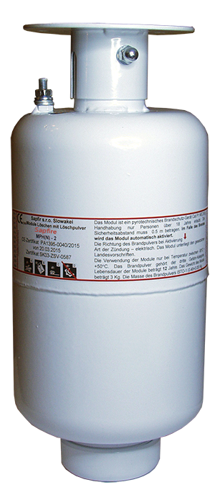
MPH - 2
Technical parameters
The module is designed to extinguish hotbeds of ignition in closed cabinets with electronic and electrical equipment of small volume, cable channels, technological equipment on the surface up to 15 m² and volume up to 28 m³.
Name of a parameter |  | Value
The volume of housing, liter |  | 2.2
Total weight, kg |  | 5.0
Weight of the fire extinguishing powder ISTO-1, kg |  | 1.9
Size, mm | diameter | 124
 | length | 280
Protected surface, m² | Class А | 15
 | Class B | 13
Protected volume, m³ | Class А | 28
 | Class B | 18
Activation current, A |  | 0.12
Service life, years |  | 10
Anti explosion label | 0ЕхiaIIВT3 Х, RP ЕхiaI Х

Slide 9
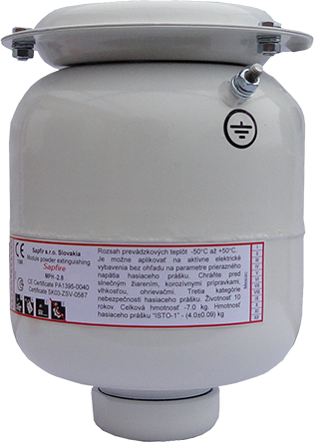
MPH – 2.8
The module is designed to extinguish hotbeds of ignition in closed cabinets with electronic and electrical equipment of small volume, cable channels, technological equipment on the surface up to 32 m² and volume up to 65 m³.
Technical parameters
Name of a parameter |  | Value
Objem krytu, liter |  | 2.8
Total weight, kg |  | 5.0
Weight of the fire extinguishing powder ISTO-1, kg |  | 4.8
Size, mm | diameter | 155
 | length | 215
Protected surface, m² | Class А | 32
 | Class B | 14
Protected volume, m³ | Class А | 65
 | Class B | 17
Activation current, A |  | 0.12
Service life, years |  | 12
Anti explosion label | 0ЕхiaIIВT3 Х, RP ЕхiaI Х

Slide 10
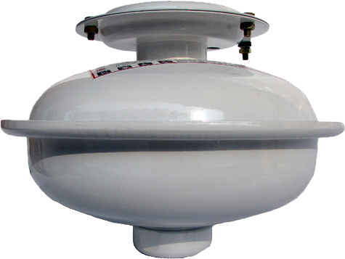
MPH - 4
Technical parameters
Name of a parameter |  | Value
The volume of housing, liter |  | 4.3
Total weight, kg |  | 7.0
Weight of the fire extinguishing powder ISTO-1, kg |  | 4.0
Size, mm | diameter | 280
 | length | 195
Protected surface, m² | Class А | 40
 | Class B | 16
Protected volume, m³ | Class А | 100
 | Class B | 20
Activation current, A |  | 0.12
Service life, years |  | 10
Anti explosion label | 0ЕхiaIIВT3 Х, RP ЕхiaI Х
The module is designed to extinguish hotbeds of ignition in closed cabinets with electronic and electrical equipment of small volume, cable channels, technological equipment on the surface up to 40 m² and volume up to 100 m³

Slide 11
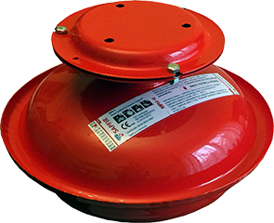
MPH - 4
Technical parameters
Name of a parameter |  | Value
The volume of housing, liter |  | 4.3
Total weight, kg |  | 7.0
Weight of the fire extinguishing powder ISTO-1, kg |  | 4.0
Size, mm | diameter | 280
 | length | 195
Protected surface, m² | Class А | 40
 | Class B | 16
Protected volume, m³ | Class А | 100
 | Class B | 20
Activation current, A |  | 0.12
Service life, years |  | 10
Anti explosion label | 0ЕхiaIIВT3 Х, RP ЕхiaI Х
The module is designed to extinguish hotbeds of ignition in closed cabinets with electronic and electrical equipment of small volume, cable channels, technological equipment on the surface up to 40 m² and volume up to 100 m³

Slide 12
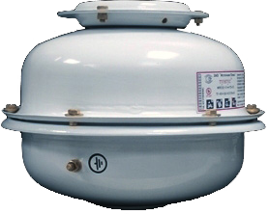
MPH – 5
Technical parameters
Name of a parameter |  | Value
The volume of housing, liter |  | 4.4
Total weight, kg |  | 8.2
Weight of the fire extinguishing powder ISTO-1, kg |  | 4.4
Size, mm | diameter | 280
 | length | 210
Protected surface, m² | Class А | 78
 | Class B | -
Protected volume, m³ | Class А | 100
 | Class B | 40
Activation current, A |  | 0.12
Service life, years |  | 10
Anti explosion label | 0ЕхiaIIВT3 Х, RP ЕхiaI Х
The module is designed to extinguish hotbeds of ignition in closed cabinets with electronic and electrical equipment of small volume, cable channels, technological equipment on the surface up to 78 m² and volume up to 100 m³
Application Area:
Raised floors and suspended ceilings, attic and basement

Slide 13
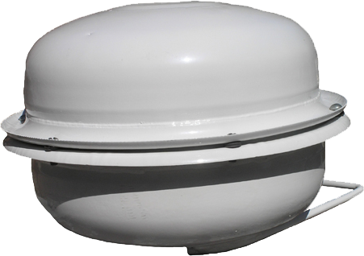
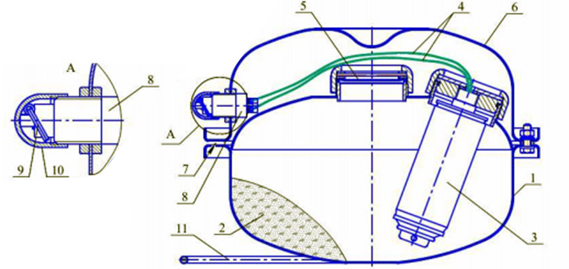
MPH – 5M
Technical parameters
Name of a parameter |  |  | Value
The volume of housing, litre |  |  | 4.7
Total weight, kg |  |  | 8.2
Weight of the fire extinguishing powder ISTO-1, kg |  |  | 4.4
Size, mm | diameter |  | 300
 | length |  | 280
Protected surface, m² | Class А |  | 200
 | Class B |  | 78
Protected volume, m³ | Class А |  | 100
 | Class B |  | 40
Activation current, A |  |  | 0.12
Service life, years |  |  | 10
Anti explosion label |  | 0ЕхiaIIВT3 Х, RP ЕхiaI Х
Module meant to be thrown into the fire, with manual start

Slide 14
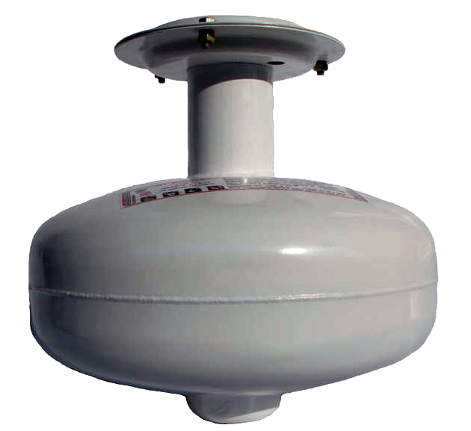
MPH - 6
Technical parameters
Name of a parameter |  | Value
The volume of housing, liter |  | 6.5
Total weight, kg |  | 10.0
Weight of the fire extinguishing powder ISTO-1, kg |  | 6.0
Size, mm | diameter | 286
 | length | 233
Protected surface, m² | Class А | 50
 | Class B | 27
Protected volume, m³ | Class А | 150
 | Class B | 38
Activation current, A |  | 0.12
Service life, years |  | 10
Anti explosion label | 0ЕхiaIIВT3 Х, RP ЕхiaI Х
The module is designed to extinguish hotbeds of ignition in closed cabinets with electronic and electrical equipment of small volume, cable channels, technological equipment on the surface up to 50 m² and volume up to150 m³

Slide 15
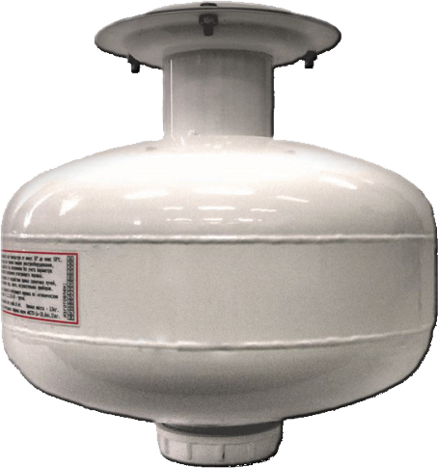
MPH - 9
Technical parameters
Name of a parameter |  | Value
The volume of housing, liter |  | 9.0
Total weight, kg |  | 13.0
Weight of the fire extinguishing powder ISTO-1, kg |  | 8.6
Size, mm | diameter | 286
 | length | 268
Protected surface (S), m² | Class А | 72
 | Class B | 33
Protected volume, m³ | Class А | 216
 | Class B | 42
Activation current, A |  | 0.12
Service life, years |  | 10
Anti explosion label | 0ЕхiaIIВT3 Х, RP ЕхiaI Х
The module is designed to extinguish hotbeds of ignition in closed cabinets with electronic and electrical equipment of small volume, cable channels, technological equipment on the surface up to 72 m² and volume up to 216 m³

Slide 16
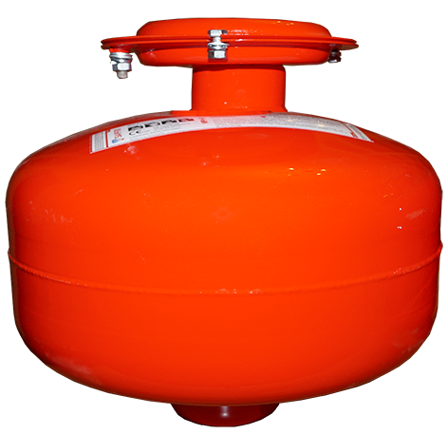
MPH - 9
Technical parameters
Name of a parameter |  | Value
The volume of housing, liter |  | 9.0
Total weight, kg |  | 13.0
Weight of the fire extinguishing powder ISTO-1, kg |  | 8.6
Size, mm | diameter | 286
 | length | 268
Protected surface (S), m² | Class А | 72
 | Class B | 33
Protected volume, m³ | Class А | 216
 | Class B | 42
Activation current, A |  | 0.12
Service life, years |  | 10
Anti explosion label | 0ЕхiaIIВT3 Х, RP ЕхiaI Х
The module is designed to extinguish hotbeds of ignition in closed cabinets with electronic and electrical equipment of small volume, cable channels, technological equipment on the surface up to 72 m² and volume up to 216 m³

Slide 17
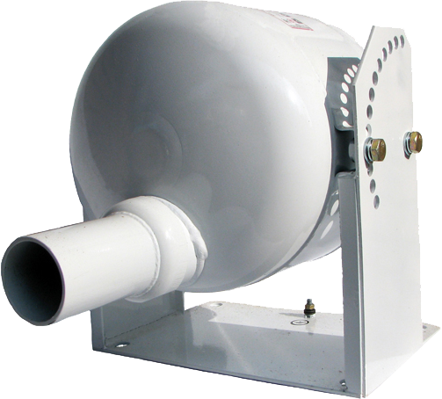
MPH – 10st
Technical parameters
Name of a parameter |  | Value
The volume of housing, liter |  | 9.5
Total weight, kg |  | 20.0
Weight of the fire extinguishing powder ISTO-1, kg |  | 9.5
Size, mm | diameter | 397
 | length | 305
Protected surface , m² | Class А | 310
 | Class B | 80
Protected volume, m³ | Class А | 36
 | Class B | 240
Activation current, A |  | 0.12
Service life, years |  | 10
Anti explosion label | 0ЕхiaIIВT3 Х, RP ЕхiaI Х
The module is designed to extinguish hotbeds of ignition in closed cabinets with electronic and electrical equipment of small volume, cable channels, technological equipment on the surface up to 80 m² and volume up to 240 m³

Slide 18
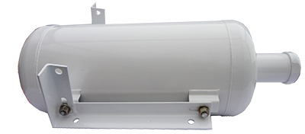
MPH - 24
Technical parameters
Name of a parameter |  | Value
The volume of housing, liter |  | 24.0
Total weight, kg |  | 36.0
Weight of the fire extinguishing powder ISTO-1, kg |  | 22.0
Size, mm | diameter | 245
 | length | 694
Protected surface , m² | Class А | 75
 | Class B | 58
Protected volume, m³ | Class А | 250
 | Class B | -
Activation current, A |  | 0.2
Service life, years |  | 10
Anti explosion label | 0ЕхiaIIВT3 Х, RP ЕхiaI Х
The module is designed to extinguish hotbeds of ignition in closed cabinets with electronic and electrical equipment of small volume, cable channels, technological equipment on the surface up to 75 m² and volume up to 250 m³

Slide 19
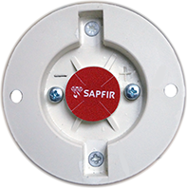
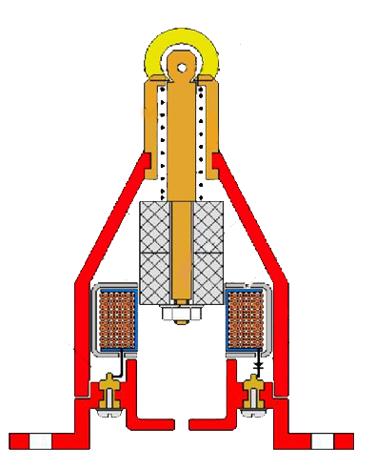
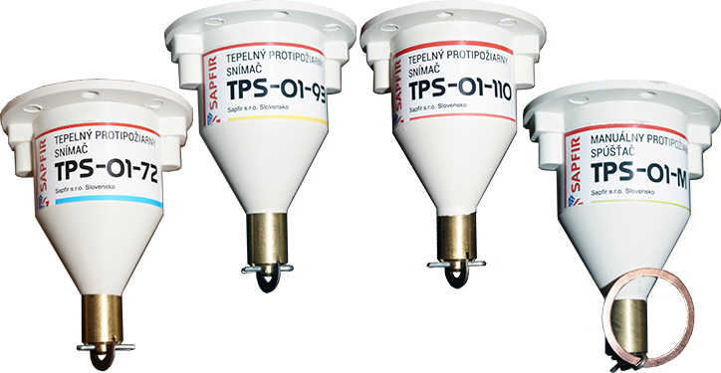
Device of the autonomous activation TPS – 01 Thermal fire-fighting sensor
Purpose:
Autonomous launch of up to 6 MPH modules in case of fire
Modifications:
TPS – 01-72
TPS – 01-93
TPS – 01-110
TPS – 01-М
Made in Slovakia

Slide 20

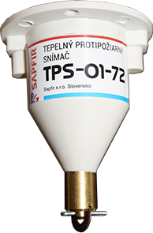
TPS – 01-72 Thermal fire-fighting sensor
Name |  | Value
Weight, g |  | ≤ 200
Size | Diameter, mm | 65,0
 | Length, mm | 85,0
Operational temperature range, °C |  | -60 ÷ +55
Temperature of automatic activation, °C |  | +72 ± 5
Impulse, generated by 1 Ohm resistance | Amplitude, V | 3.5
 | Amplitude, A | 3.0
 | Length, ms | 1
Anti explosion label |  | 1ExibIIBT4
Service span without maintenance |  | 10
Purpose: TPS is unique autonomous Thermal activation and detection device that allows you to capture fire and activate powder, aerosol or gas fire suppression system.
Made in Slovakia

Slide 21
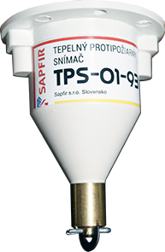
TPS – 01-93 Thermal fire-fighting sensor
Name |  | Value
Weight, g |  | ≤ 200
Size | Diameter, mm | 65,0
 | Length, mm | 85,0
Operational temperature range, °C |  | -60 ÷ +70
Temperature of automatic activation, °C |  | +93 ± 5
Impulse, generated by 1 Ohm resistance | Amplitude, V | 3.5
 | Amplitude, A | 3.0
 | Length, ms | 1
Anti explosion label |  | 1ExibIIBT4
Service span without maintenance |  | 10
Purpose: TPS is unique autonomous Thermal activation and detection device that allows you to capture fire and activate powder, aerosol or gas fire suppression system.
Made in Slovakia

Slide 22
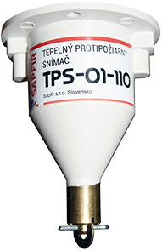
TPS – 01-110 Thermal fire-fighting sensor
Name |  | Value
Weight, g |  | ≤ 200
Size | Diameter, mm | 65,0
 | Length, mm | 85,0
Operational temperature range, °C |  | -60 ÷ +100
Temperature of automatic activation, °C |  | +110 ± 5
Impulse, generated by 1 Ohm resistance | Amplitude, V | 3.5
 | Amplitude, A | 3.0
 | Length, ms | 1
Anti explosion label |  | 1ExibIIBT4
Service span without maintenance |  | 10
Purpose: TPS is unique autonomous Thermal activation and detection device that allows you to capture fire and activate powder, aerosol or gas fire suppression system.
Made in Slovakia

Slide 23
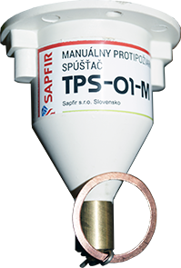
TPS – 01-110 Manual trigger
Name |  | Value
Weight, g |  | ≤ 200
Size | Diameter, mm | 65,0
 | Length, mm | 85,0
Operational temperature range, °C |  | -60 ÷ +100
Temperature of activation, °C |  | manual
Impulse, generated by 1 Ohm resistance | Amplitude, V | 3.5
 | Amplitude, A | 3.0
 | Length, ms | 1
Antiexplosion label |  | 1ExibIIBT4
Service span without maintenance |  | 12
Purpose: TPS is unique autonomous manual activation device that allows capture of fires and manual activation of powder, aerosol or gas fire suppression system.
Made in Slovakia

Slide 24
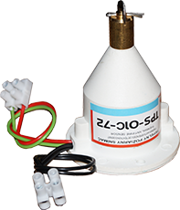
Modifications:
TPS – 01C-72
TPS – 01C-93
TPS – 01C-110
Name |  | Value
Weight, g |  | ≤ 200
Size | Diameter, mm | 65,0
 | Length, mm | 85,0
Operational temperature range, °C |  | -60 ÷ +100
Impulse, generated by 1 Ohm resistance | Amplitude, V | 3.5
 | Amplitude, A | 3.0
 | Length, ms | 1
Antiexplosion label |  | 1ExibIIBT4
Service span without maintenance |  | 12
Purpose: TPS is unique autonomous Thermal activation and detection device that allows capture of fire and activation of powder, aerosol or gas fire suppression systems. The apparatus also includes the possibility of a signal delivery to the fire panel and a switch for electronic equipment or activation of the alarm system.
Made in Slovakia

Slide 25
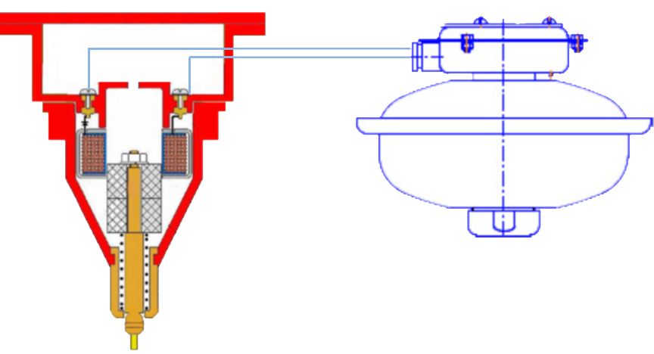
Autonomous activation device TPS – 01

Slide 26
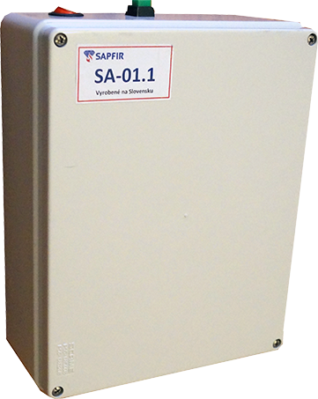
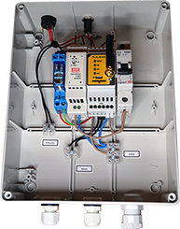
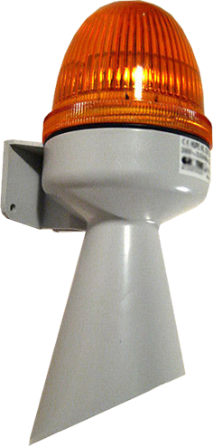
SA-01.1 Alarm system
Made in Slovakia

Slide 27
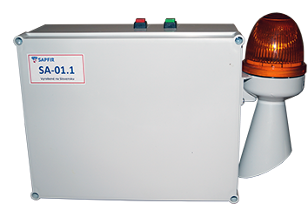

SA-01
The alarm siren with beacon
Technical parameters SA-01
Sizes of the siren, mm 76×79×204
Sizes of the box, mm 245×190×100
Weight, kg 1,150
Voltage, V 230,0
Power, W 6,0
Sound volume, dB 92,0
Electricity consumption, A 0,1
Color of lamp cover Oranžová (červena)
Type of the acoustic signal Alarm
Level of coverage (IP) IP43
Activation device TPS-01
Range of operational temperature, °C -30 ÷ +50
Made in Slovakia

Slide 28
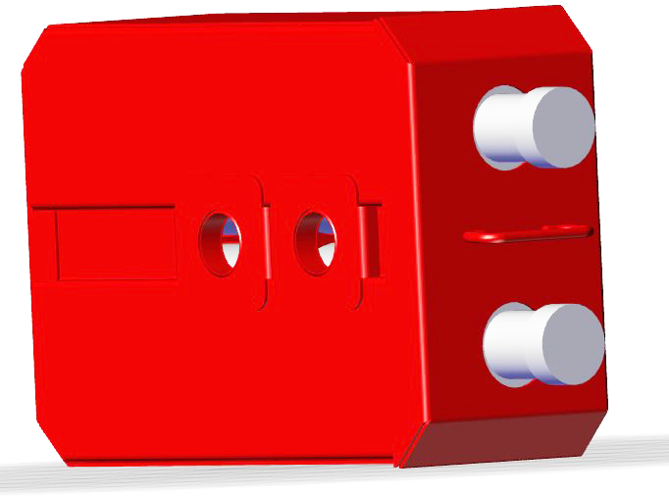
Fire extinguishing casette TPS-2.24
Name of the parameter | Value
Number of modules in a single system | 2
Protected surface, m² | 150
Protected volume, m³ | 500
Operational temperature range, °C: | -50 ÷ +50
Service span, years | 12
Usage:
Usage of the casette as a part of the fire protection vehicle, visibly rases the abilities of the fire extinguishing squad and lowers the chance of burns and various dangers when extinguishing fires on the heigth. It also allows to easily block the hotbeds and protect the personell in the rooms where fire has already spread.
Casette TPS-2.24 is built from two modules of powder fire extinguishing MPH MPH-24 and is a device of the multiple usage. It also does not require any technical maintenance for 12 years of service.
Made in Slovakia

Slide 29
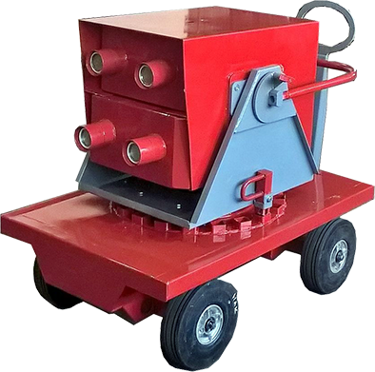
Mobile fire fighting system TPS -4.24
Name | Hodnota
The number of modules in the system, pieces | 4
Protected surface, m2 | 300
Protected volume, m3 | 1000
Operational temperature, °C | -50 ÷ +50
Span of service without maintenance, years | 12

Slide 30
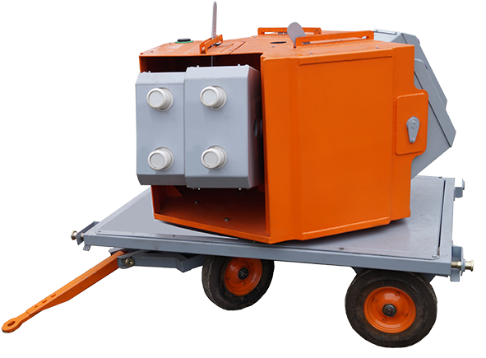
Mobile fire fighting system TPS-12.24
Name |  | Value
Weight (without carrier), kg |  | ≤ 630
Size, mm | Height | 1400,0
 | Length | 2000,0
 | Width | 1500,0
Protected surface, m² | Class A | 900
 | Class B | 700
Protected volume, m³ | Class A | 6000
 | Class B | -
Activation method |  | Manual
Operational temperature, °C |  | -50 ÷ +50
Span of service without maintenance, years |  | 12
Made in Slovakia

Slide 31
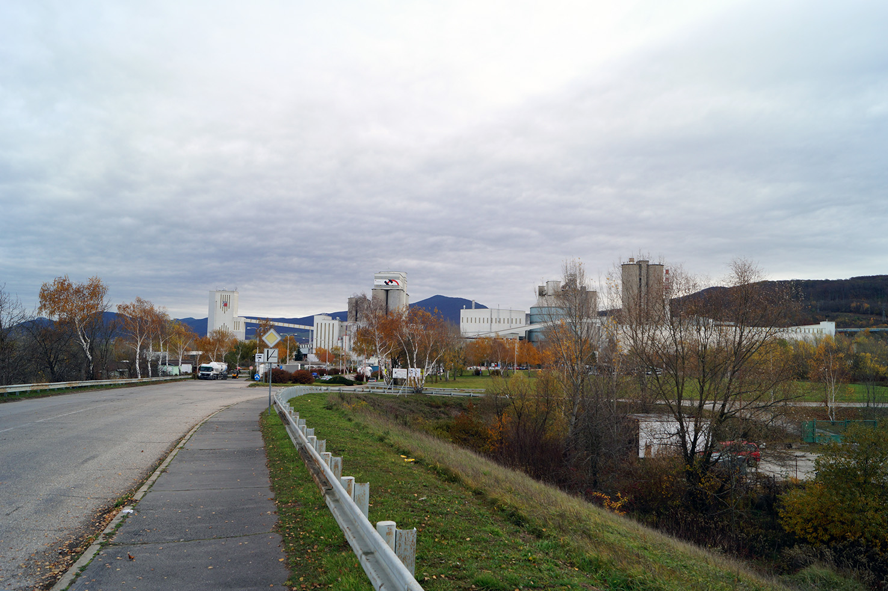
CRH (Slovensko) a.s.
Antifire system SA10.001.01. 2015

Slide 32
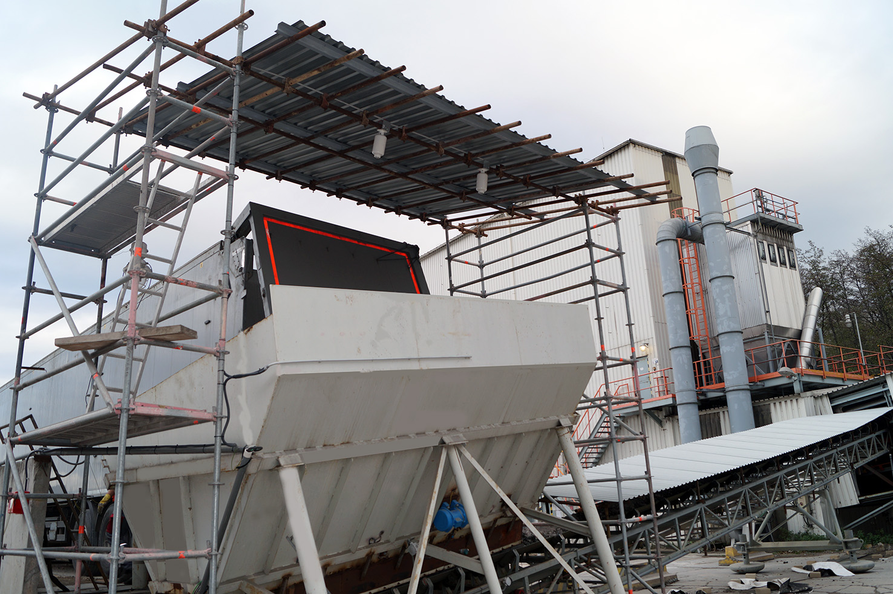
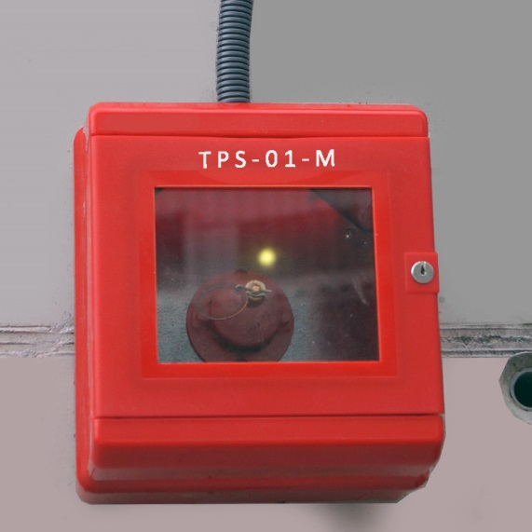
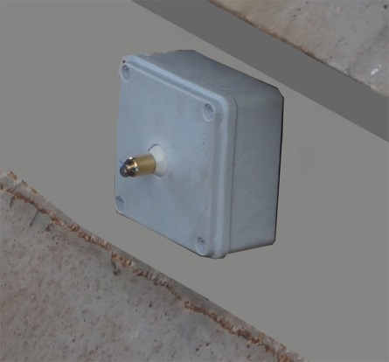
Antifire system SA10.001.01. 2015
Made in Slovakia

Slide 33
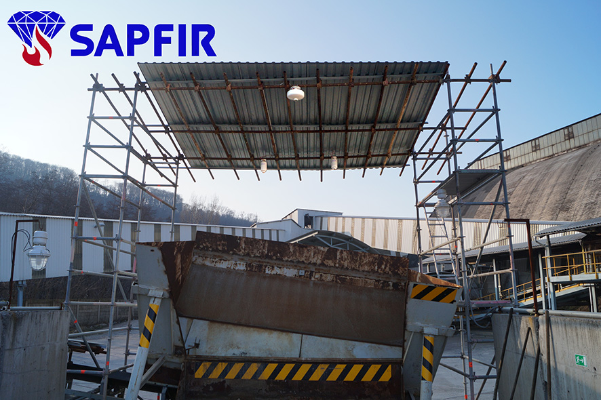
Antifire system SA10.001.01. 2015
Made in Slovakia

Slide 34
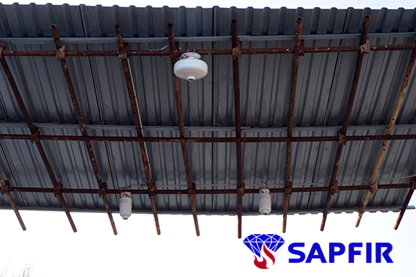
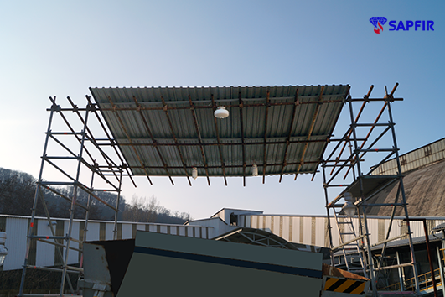
Antifire system SA10.001.01. 2015
CRH (Slovensko) a.s.
Made in Slovakia

Slide 35
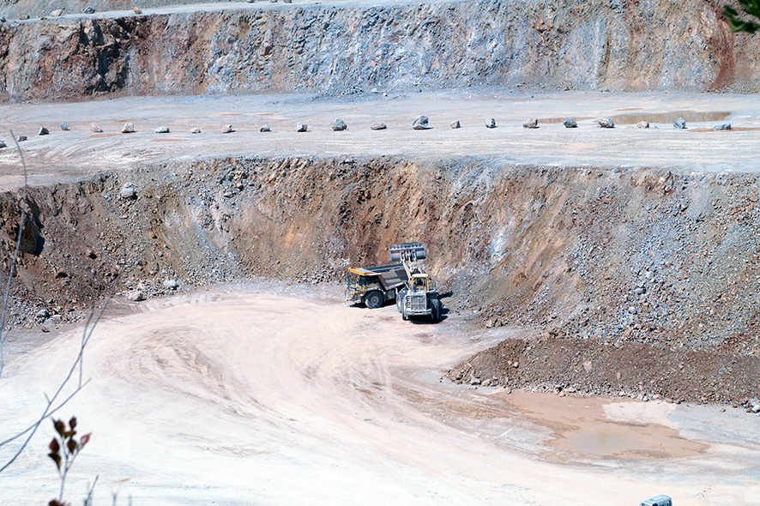
CRH (Slovensko) a.s.
Antifire System SA10.005.01.2016

Slide 36
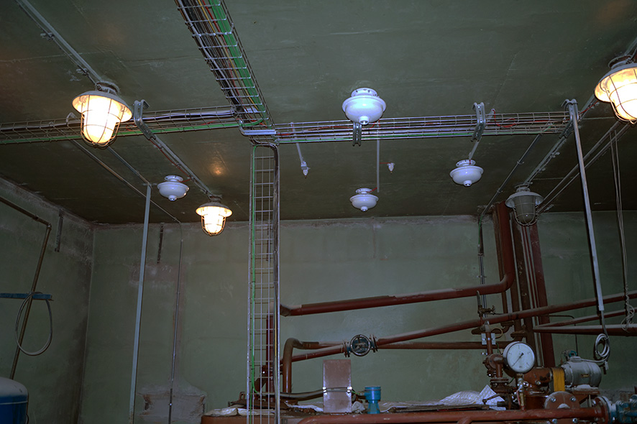
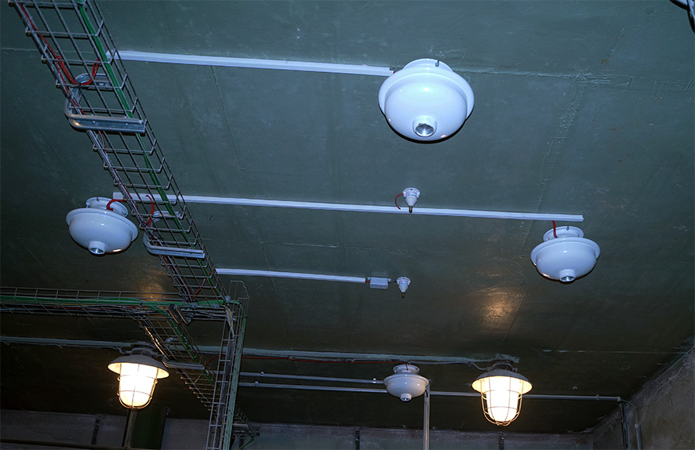
Antifire System SA10.005.01.2016
CRH (Slovensko) a.s.
Made in Slovakia

Slide 37
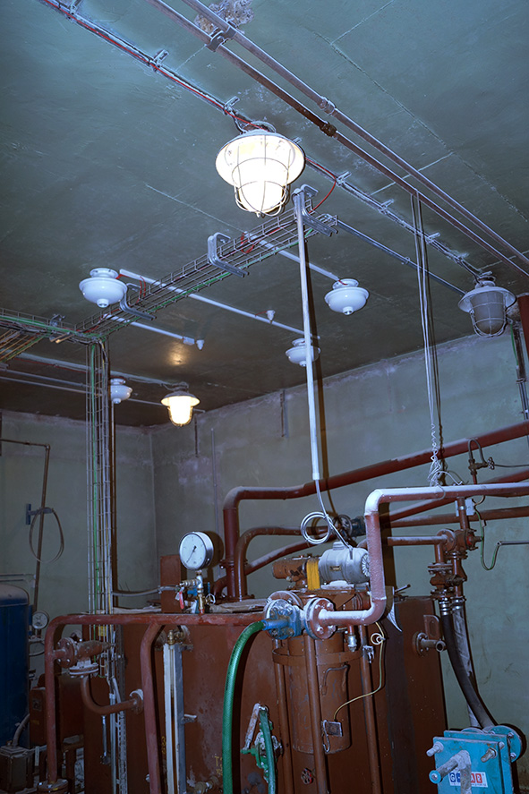
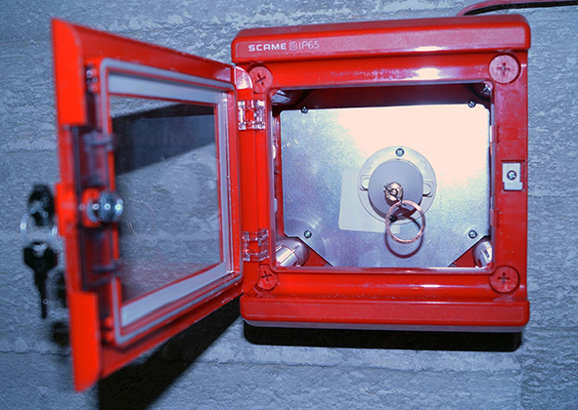
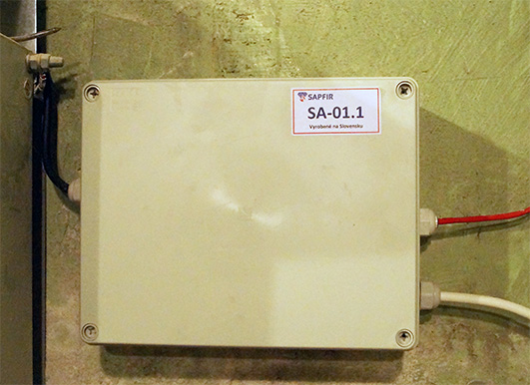
Antifire System SA10.005.01.2016
CRH (Slovensko) a.s.
Made in Slovakia

Slide 38
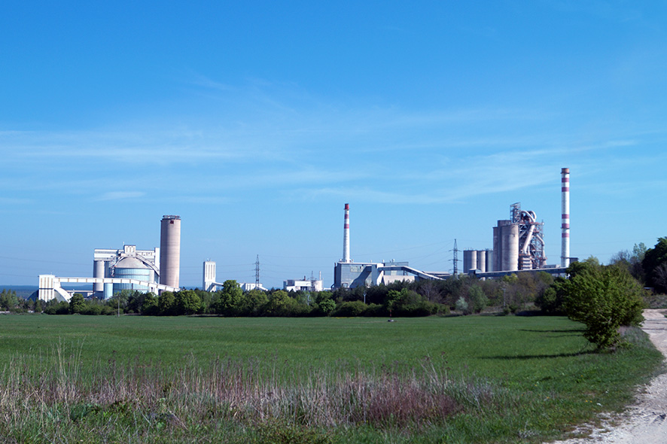
CRH (Slovensko) a.s.
Antifire System SA10.011.01.2016

Slide 39
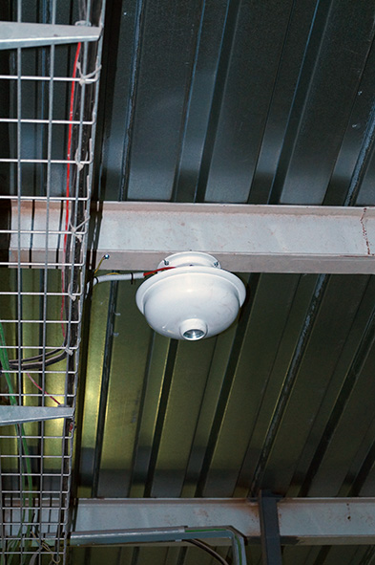


Antifire System SA10.011.01.2016
CRH (Slovensko) a.s.
Made in Slovakia

Slide 40




Antifire System SA10.011.01.2016
CRH (Slovensko) a.s.
Made in Slovakia

Slide 41




Antifire System SA10.011.01.2016
Made in Slovakia

Slide 42






Antifire System SA10.011.01.2016

Slide 43

Hyundai DYMOS Slovakia s.r.o.
Antifire System SA10.004.01.2016

Slide 44



Antifire System SA10.004.01.2016
Hyundai DYMOS Slovakia s.r.o.
Made in Slovakia

Slide 45



Antifire System SA10.004.01.2016
Hyundai DYMOS Slovakia s.r.o.
Made in Slovakia

Slide 46



Antifire System SA10.004.01.2016
Hyundai DYMOS Slovakia s.r.o.
Made in Slovakia

Slide 47


MPH – 9
A heat generator

Slide 48


MPH – 9
A heat generator

Slide 49

Bombardier Transportation Czech Republic, a.s.
Antifire System SA10.003.02.2016

Slide 50


Bombardier Transportation Czech Republic, a.s.
MPH-9
MPH-4
Antifire System SA10.003.02.2016
Made in Slovakia

Slide 51

Hyundai DYMOS Czech s.r.o.
Antifire System SA10.008.01.2016

Slide 52


Hyundai DYMOS Czech s.r.o.
Antifire System SA10.008.01.2016

Slide 53

Hyundai DYMOS Czech s.r.o.
Antifire System SA10.008.01.2016

Slide 54





Hyundai DYMOS Czech s.r.o.
Antifire System SA10.008.01.2016

Slide 55


MPH – 6
MPH – 9
The production line in Judetul Mures, Romania
Stock Judetul Mures, Romania

Slide 56


MPH – 6

Slide 57


MPH – 4
MPH – 6
Garage in Nitra, Slovakia
The generation container in Czech Republic

Slide 58


MPH – 6
MPH - 24
Warehouse in Pardubice, Czech Republic

Slide 59


TPS – S – 01

Slide 60


Slide 61










MPH – 4
Marec, 2016, Slovnaft

Slide 62

MPH – 5M

Slide 63

Synthesia, a.s., Pardubice, Czech Republic
Antifire System SA10.007.02.2016

Slide 64


MPH – 10 st
MPH – 2
Cable channels in Pardubice, Synthesia a.s.
Dĺžka, m | 1120
MPH-10st, pieces | 68
MPH-9, pieces | 15
MPH-6, pieces | 20
MPH-5, pieces | 22
TPS-01-72, pieces | 129

Slide 65


Cable channel
Antifire System SA10.007.02.2016

Slide 66




Cable channel
Antifire System SA10.007.02.2016

Slide 67

Cable channel
Antifire System SA10.007.02.2016

Slide 68


Cable channel
Antifire System SA10.007.02.2016

Slide 69


MPH – 4
Wind electricity production station , Steinberg & CO

Slide 70

Škoda AUTO, a.s., Mladá Boleslav, Czech Republic
Fire System SA10.012.02.2016

Slide 71

Fire System SA10.012.02.2016
Škoda AUTO, a.s., Mladá Boleslav, Czech Republic

Slide 72

Aupark Bratislava
Fire System SA10.014.01.2016

Slide 73



Aupark Bratislava
Fire System SA10.014.01.2016

Slide 74






Aupark Bratislava
Fire System SA10.014.01.2016

Slide 75






Aupark Bratislava
Fire System SA10.014.01.2016

Slide 76

OLO as s.r.o. Bratislava
Fire System SA10.015.04.2016

Slide 77

OLO as s.r.o. Bratislava
Fire System SA10.015.04.2016 Gas station

Slide 78


OLO as s.r.o. Bratislava
Fire System SA10.015.04.2016 Gas station

Slide 79


OLO as s.r.o. Bratislava
Fire System SA10.015.04.2016 Gas station

Slide 80

OLO as s.r.o. Bratislava
Fire System SA10.015.04.2016 Turbogenerator

Slide 81





OLO as s.r.o. Bratislava
Fire System SA10.015.04.2016 Turbogenerator

Slide 82





OLO as s.r.o. Bratislava
Fire System SA10.015.04.2016 Turbogenerator

Slide 83















Sapfir s.r.o.
Záhradná 19, 90024 Veľký Biel, Slovak Republic
Phone in Slovakia: +421245916247, +421907748884 Phone in Germany: +491755737565
info@sapfir-sro.eu
www.sapfir-sro.eu
Partner in Latvia: FN SERVISS
www.fnserviss.lv
Tel:

